Slide 1

SERVERLESS COMPUTING: REDUCING INFRASTRUCTURE MANAGEMENT IN THE CLOUD
CSA1508-CLOUD COMPUTING IN BIG DATA ANALYSIS
Guide By
Dr . CHENNI KUMARAN.J
Presented By
Aparna . T (192524213)

Slide 2
Introduction
Serverless computing is a cloud computing model where the cloud provider manages the servers and infrastructure.
Developers focus only on writing and deploying application code.
Resources automatically scale based on application demand.
Users pay only for the actual execution time of their applications.

Slide 3
FUNCTION AS A SERVICE (FAAS)
FaaS allows developers to execute individual functions without managing servers.
Functions are triggered automatically by events such as HTTP requests or file uploads.
The cloud provider allocates resources and stops them after execution.
Popular FaaS platforms include AWS Lambda, Azure Functions, and Google Cloud Functions.

Slide 4
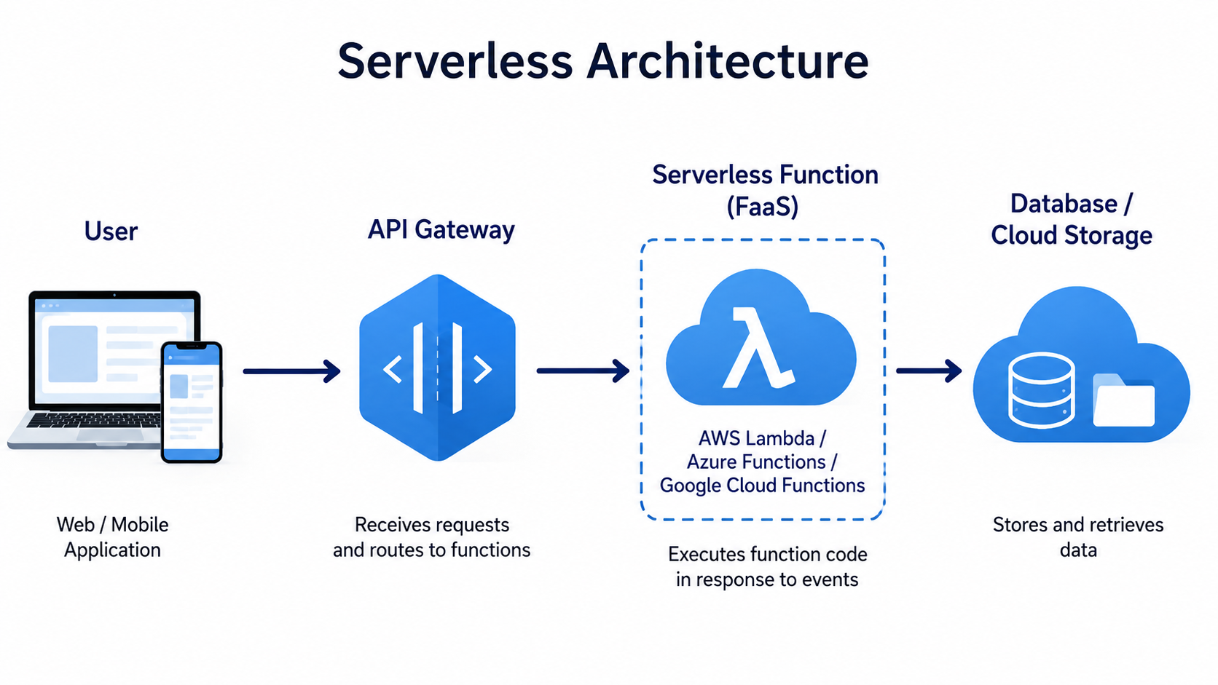

Slide 5
Advantages
Eliminates the need to manage or maintain physical servers.
Automatically scales resources during high and low traffic.
Reduces operational costs with a pay-per-use pricing model.
Enables faster development and deployment of cloud applications.

Slide 6
Business Benefits
Why Businesses Use Serverless
Helps organizations reduce infrastructure and maintenance costs.
Improves developer productivity by simplifying application deployment.
Supports faster innovation and shorter development cycles.
Ensures high availability and reliable application performance.

Slide 7
REAL-WORLD APPLICATIONS
Practical Applications
Processing uploaded images, videos, and documents.
Building chatbots and virtual assistants.
Managing IoT sensor data in real time.
Sending automated emails, notifications, and alerts.

Slide 8
CHALLENGES
Limitations
Initial requests may experience a cold start delay.
Functions have execution time and memory limitations.
Applications may become dependent on a specific cloud provider.
Monitoring and debugging distributed functions can be challenging.

Slide 9
REAL-WORLD EXAMPLE – NETFLIX
Netflix Using Serverless
Netflix uses AWS Lambda to automate cloud infrastructure
management.
Serverless functions process millions of streaming-related events.
Automatic scaling ensures reliable service during peak traffic.
This approach reduces operational effort and improves performance.

Slide 10
CONCLUSION
Serverless computing simplifies cloud application development and deployment.
It reduces infrastructure management and operational complexity. Automatic scaling and pay-per-use pricing improve cost efficiency.
It is an ideal solution for modern, scalable, and event-driven applications.

Slide 11
THANK YOU

